Slide 1


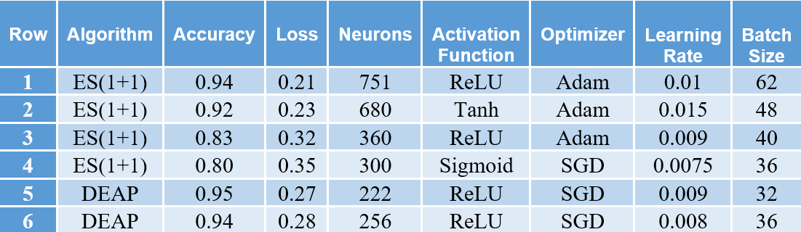

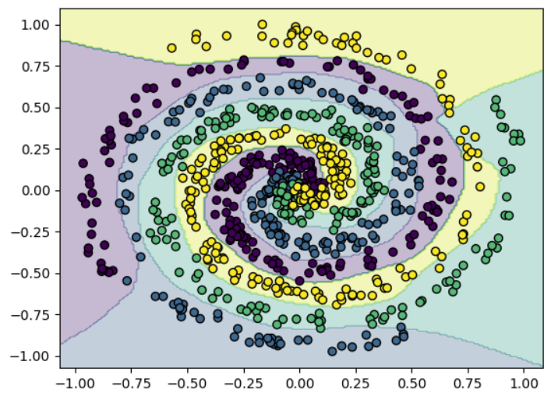
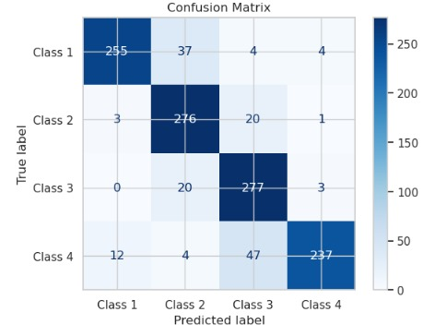
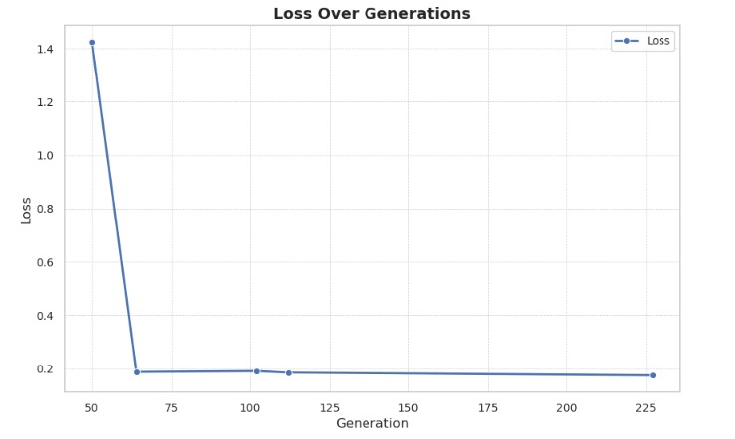
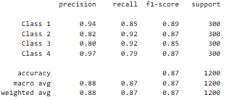
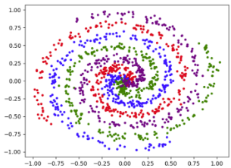
A 4-Class Spiral Case Study Using DNN Optimization
Using Evolutionary Strategies And DEAP
Siri Sri Churakanti, Batyr Kenzheakhmetov, Bhavesh Krishnaram Bhavesh, CJ Chung, College of Arts and Sciences, Lawrence Technological University
Research Goals
Results
Introduction
Methodology
The four-class spiral problem is a benchmark challenge in machine learning, known for its nonlinear separability and complexity. This study leverages evolutionary strategies (ES) to optimize deep neural networks (DNNs) for effective classification. Using the DEAP library, an enhanced ES(1+1) algorithm with the 1/5 success rule dynamically tunes key hyperparameters, including layers, neurons, learning rates, batch sizes, and activation functions. By mimicking natural selection processes, ES enables adaptive exploration of the hyperparameter space and architectural adjustments, making it a valuable approach for nonlinear problems.
Results demonstrate that ES(1+1) and its variant with the 1/5 rule significantly improve model performance, achieving high accuracy and efficient optimization. Visualizations of decision boundaries confirm its effectiveness in handling complex datasets. This research highlights the practical application of ES in deep learning and provides a robust framework for addressing challenging machine learning tasks, emphasizing adaptability and performance improvements.
DNN Architecture:
Input Layer: Features from the dataset.
Hidden Layers: Three fully connected layers with neuron counts: 128, 64, and 32.
Activation Functions: ReLU, Tanh, Sigmoid, and ELU were evaluated for optimal performance.
Output Layer: A four-class softmax classifier.
Evolutionary Strategy Optimization:
ES(1+1) Algorithm: Starts with a parent solution . An offspring is generated via mutation: The offspring replaces the parent if it yields a lower validation loss.
If the offspring yields better fitness (lower validation loss), it replaces the parent. This iterative process ensures improvement of the solution. In the variant with the 1/5 success rule, step size adaptation is incorporated: the mutation step size increases when at least 20% of the offspring are successful (leading to improvement) and decreases otherwise. This dynamic adjustment allows efficient exploration and exploitation of the search space, adapting to the problem's complexity.
Fitness Evaluation:
Fitness is determined using validation loss , calculated as: where is the batch size, is the number of classes, is the true label, and is the predicted probability.
Training and Selection:
The Adam optimizer was used with early stopping to prevent overfitting. The best model was selected based on the lowest validation loss.
Visualization:
Decision boundaries were visualized on a dense grid, and the convergence of loss was plotted across generations to assess the effectiveness of ES strategies.
Best Model: Row 5 (DEAP) with 0.95 accuracy
Smallest Model with Acceptable Accuracy: Row 6 (DEAP) with 0.94 accuracy
Row 5: Decision Boundary Plotting
Row 1: Confusion Matrix Visualizations
Research Goals
To demonstrate the effectiveness of evolutionary strategies (ES) for dynamically optimizing hyperparameters and architectures of deep neural networks (DNNs) to solve the challenging 4 class spiral problem, while providing insights into the application of ES for addressing nonlinear and complex machine learning tasks.
This goal highlights the innovative use of ES for:
Hyperparameter Optimization: Dynamically tuning layers, neurons, learning rate, and activation functions.
Architectural Adaptation: Adjusting the DNN structure to improve performance on nonlinear data.
Generalizability: Showcasing the potential of ES for tackling other complex problems in machine learning.
Row 1:Loss Over Generations
Conclusion
Row 1: Classification Report of ES(1+1)
This research demonstrates the effectiveness of evolutionary strategies (ES) in optimizing deep neural networks (DNNs) for the challenging four-class spiral problem, achieving a peak accuracy of 96.88% using the DEAP framework. By dynamically tuning hyperparameters such as neurons per layer, optimizer types, learning rates, and batch sizes, ES-based methods showcased their adaptability and robustness in addressing nonlinear and overlapping patterns. The study successfully adapted the DNN architecture to handle the complexity of the dataset and demonstrated generalizability for nonlinear classification tasks.
The research successfully meets its goals by dynamically optimizing hyperparameters, adapting DNN architecture, and demonstrating the generalizability of ES for solving nonlinear and complex machine learning tasks. The use of genetic operators, including Gaussian mutation, crossover, and tournament selection, played a significant role in facilitating robust optimization and steady fitness improvements. These findings confirm that ES-based methods are highly effective in addressing intricate machine learning challenges.
In essence, this research establishes evolutionary strategies as a versatile and scalable approach for enhancing DNN performance in nonlinear classification tasks. It offers valuable insights for future studies and practical applications, emphasizing the adaptability of ES in advancing deep learning methodologies. The study also invites further exploration of hybrid models and scalable frameworks to expand the scope of ES-based optimization in artificial intelligence
Dataset Generation
The dataset is constructed as four spirals, each represented in polar coordinates. For a class 𝑐, the spiral points are generated using the equations:
x(t) = a · t · cos(t + b), y(t) = a · t · sin(t + b)
where t∈[0,10] is the angle, 𝑎 is a scaling factor, and 𝑏 determines the angular offset for each class (b= 0, π/2, π, 3π/2).
Gaussian noise 𝑁(𝜇,𝜎²) is added to each point to simulate real-world imperfections.
The input data X ∈ ℝⁿˣ² is standardized
to zero mean and unit variance using:
X' = (X - μₓ) / σₓ.
Reference
Back, T. (1996). Evolutionary Algorithms in Theory and Practice: Evolution Strategies, Evolutionary Programming, Genetic Algorithms. Oxford University Press.
Fortin, F.-A., De Rainville, F.-M., Gardner, M.-A., Parizeau, M., & Gagné, C. (2012). DEAP: Evolutionary Algorithms Made Easy. Journal of Machine Learning Research, 13, 2171–2175.
Goodfellow, I., Bengio, Y., & Courville, A. (2016). Deep Learning. MIT Press.
Hansen, N., & Ostermeier, A. (2001). Completely Derandomized Self-Adaptation in Evolution Strategies. Evolutionary Computation, 9(2), 159–195.
Heaton, J. (2018). Introduction to Neural Networks for Java and Python. Heaton Research.
Rumelhart, D. E., Hinton, G. E., & Williams, R. J. (1986). Learning Representations by Back-Propagating Errors. Nature, 323(6088), 533–536.

